Slide 1
Franchise Success Team Media Kit
Elevate Your Franchise to Unstoppable Success

Slide 2
OUR VALUES
Our Mission and Culture
With over 25+ years of experience working within the franchise industry, we offer the expertise you need for your brand. Our services span a comprehensive array of support, including franchise marketing, legal aid, human resources, benefits, business development, training, and consulting. Our passion lies in facilitating franchise growth—both in attracting potential franchisees through targeted sales leads and in enhancing local market presence for individual franchises.

Slide 3
COMPREHENSIVE SERVICES
Digital Marketing Services
Franchise Success Team offers a full range of digital marketing services designed to help franchises succeed at every level. Our services include:
Franchise Marketing:
Local, regional, and national marketing strategies tailored for franchise success.
SEO and Content Creation:
Powerful SEO strategies and content that improve visibility and drive traffic.
Social Media Management:
Custom strategies that engage your audience and boost brand awareness.
Paid Advertising:
ROI-focused campaigns across Google, Facebook, Instagram, and more.
Website Development:
WordPress multi-site solutions to ensure brand consistency across all franchise locations.
Email Marketing:
Personalized campaigns to nurture leads and build lasting relationships.

Slide 4
OUR SERVICES
6 comprehensive services
Franchise Success Team empowers you at every stage of your journey, giving you the experts you need to thrive in a competitive marketplace.
Franchise Marketing:
Simplify your financial management with expert franchise accounting services that keep your business on track.
Franchise Benefits:
Attract and retain top talent with customized franchise benefit solutions designed to meet your team’s needs.
Franchise Training:
Equip your team with the skills and knowledge they need to excel with our tailored franchise training programs.
Franchise HR:
Streamline your hiring and employee management with professional HR services tailored to franchise operations.
Franchise Legal:
Protect your franchise with comprehensive legal support, ensuring compliance and minimizing risk.
Franchise Coaching:
Accelerate your success with personalized franchise coaching that helps you overcome challenges and drive growth.

Slide 5
OUR PARTNERS
Trusted by Franchise Brands Nationwide
Our proven strategies have helped franchise brands across various industries grow, thrive, and succeed. See why leading franchises trust us to boost their visibility, generate leads, and drive lasting results.
Tailored Marketing Solutions: We customize strategies to fit the unique needs of your franchise, ensuring growth at both local and national levels.
Proven Lead Generation: Our digital marketing techniques consistently deliver high-quality leads that convert into loyal customers.
Comprehensive Support: From brand consistency to local- ized campaigns, we provide end-to-end marketing solutions for franchises of all sizes.

Slide 6
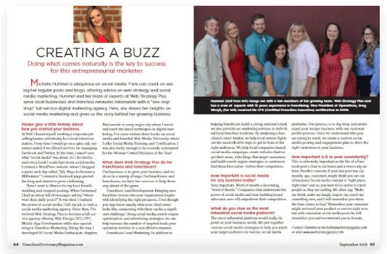
OUR PRESS
In the News: Our Press Features
As a trusted voice in the franchise industry, Michelle Hummel, CEO of
Franchise Success Team, regularly contributes expert insights to leading publications such as Franchise Wire, Franchise Dictionary Magazine, and The Franchise Woman. Her expertise and dedication have earned her the title of Best Digital Marketing Agency in Cincinnati and a nomination for Woman-Owned
Business of the Year.
Industry Expertise: Featured in top franchise publications, providing valuable insights on digital marketing and franchise growth strategies.
Award-Winning Agency: Recognized as the Best Digital Marketing Agency in Cincinnati for delivering outstanding results.
Women-Owned Business Leader: Nominated for Woman-Owned Business of the Year, highlighting dedication to empowering businesses and driving success.

Slide 7
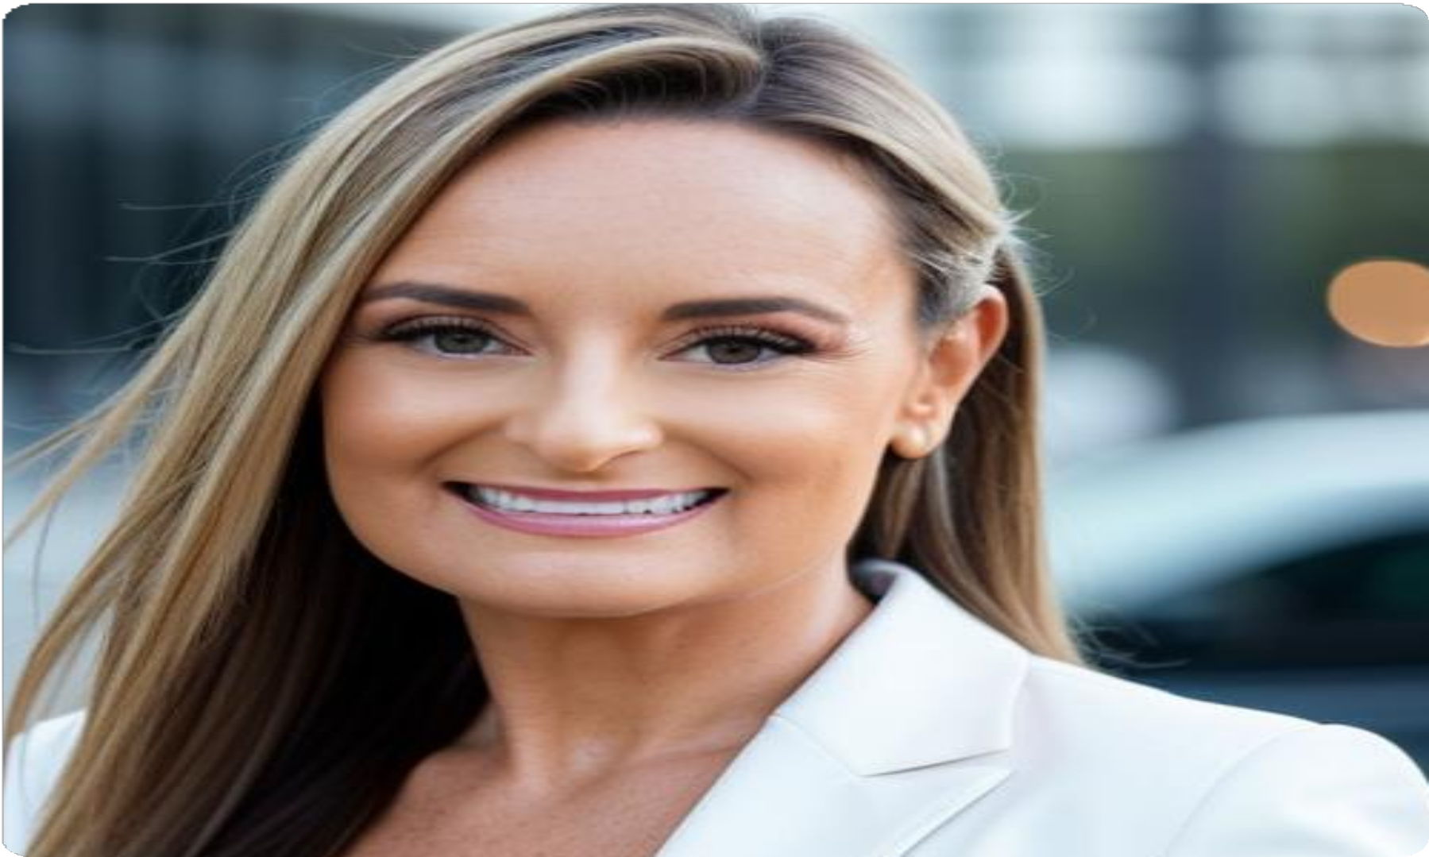
MEET OUR CEO AND FOUNDER: MICHELLE HUMMEL
Our Leadership:
Michelle Hummel, CEO and Founder
Michelle Hummel is a distinguished digital marketing authority with over 15 years of proven success in crafting effective marketing strategies for franchises. As the visionary CEO and Founder of Franchise Success Team, her commitment to empowering franchises is unwavering, driving them towards remarkable growth and sustained success. Michelle proudly holds the title of 2X Cincinnati’s Business Person of the Year and is a respected nominee for Woman-Owned Business of the Year.

Slide 8
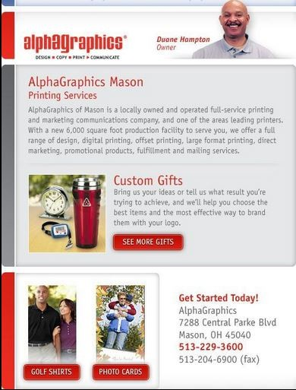
AWARD-WINNING DESIGNS
Our Award-
Winning Designs
Our team is proud to have received industry recognition for our cutting-edge designs and innovative solutions. We focus on delivering visually stunning, user-friendly websites and marketing materials that drive conversions and enhance the customer experience.

Slide 9
CLIENT SUCCESS STORIES
Client Success Stories: Driving Real Results
We measure our success by the success of our clients. Here are a few stories that highlight how Franchise Success Team has helped franchises grow, increase leads, and boost sales:
Restaurant Franchise: Increased local foot traffic by 40% through targeted social media campaigns and geo- targeted ads, resulting in a surge of new customers.
Fitness Franchise: Boosted lead generation by 60% within six months by revamping their website and implementing a comprehensive SEO and content strategy.
Home Services Franchise: Achieved a 35% increase in online bookings through a tailored paid advertising campaign, driving consistent growth across multiple locations.

Slide 10
TESTIMONIALS
What Our Clients Are Saying
Hear directly from the franchise owners we’ve helped:
Franchise Success Team transformed our digital presence! We saw a 40% boost in leads within just a few months. Their expertise is unmatched!"
"Thanks to Michelle and her team, our social media engagement skyrocketed. We’re now generating more qualified leads than ever before!"
“The tailored marketing strategies they provided helped us grow across multiple locations. Their support has been invaluable!"
John S.
Restaurant Franchise Owner
Sarah L.
Fitness Franchise Owner
David M.
Home Services Franchise Owner

Slide 11
OUR PROCESS
Our Process: A Proven Path to Success
At Franchise Success Team, we follow a proven process to ensure our clients achieve the best results:
1
Discovery: We start by understanding your unique needs and challenges.
2
Strategy: Our team creates a custom marketing plan tailored to your goals.
3
Execution: We implement and manage your marketing campaigns across all platforms.
4 Optimization: We continuously monitor and refine strategies for maximum impact.
5
Reporting: We provide regular reports so you can track progress and results.

Slide 12
WHY CHOOSE US?
Why Choose
Franchise Success Team?
When you partner with Franchise Success Team, you’re choosing a team of dedicated experts who understand the franchise industry. We are results-driven, client-fo- cused, and passionate about helping franchises succeed. Our personalized approach, combined with our years of experience, makes us the go-to partner for franchises looking to thrive.

Slide 13
Let’s Grow Your Franchise Together
Ready to take your franchise to the next level? Contact us today to learn more about how we can help you achieve your goals.
CONTACT US
Contact Details:
888-305-3876
info@franchisesuccessteam.com www.franchisesuccessteam.com

